Slide 1

NSG Pilkington – University of Liverpool Machine Learning Project: 25/11/2020
Dr. Peter Green
Diego Echeverria
Risk Institute,
School of Engineering

Slide 2
To-do (short-term)
Run the pre-processing tasks defined in the flow chart with the 170 inputs specified in the spreadsheet “UK5 AI Furnace Model Input Pre-Processing”.
Define a strategy to combine the signals identified with the “Indirect TagID” labels in the “UK5 AI Furnace Model Input Pre-Processing” spreadsheet.
Once the combination strategy is defined, identify groups of correlated tags using Feature Selection.
Updates related to the Multiple Linear Regression model.
To-do (longer-term)
Repeat analysis that use randomly selected inputs and/or randomly selected time lags.
Consider using a multi-output linear regression.

Slide 3
To-do (short-term)
Run the pre-processing tasks defined in the flow chart with the 170 inputs specified in the spreadsheet “UK5 AI Furnace Model Input Pre-Processing”.
Define a strategy to combine the signals identified with the “Indirect TagID” labels in the “UK5 AI Furnace Model Input Pre-Processing” spreadsheet.
Once the combination strategy is defined, identify groups of correlated tags using Feature Selection.
Updates related to the Multiple Linear Regression model.
To-do (longer-term)
Repeat analysis that use randomly selected inputs and/or randomly selected time lags.
Consider using a multi-output linear regression.

Slide 4
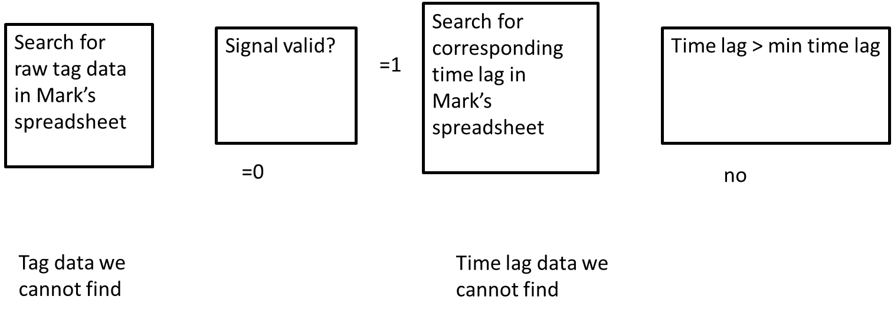
Pipeline changes for the new spreadsheet
First section of the pipeline
Only when Signal valid and Enable are equal to 1 proceed. Otherwise, ignore.
Get time lags
Enable?
Record Tag data
we cannot find

Slide 5
Pipeline changes for the new spreadsheet
Should we use the inputs identified with low resolution?
We are currently ignoring low resolution tags. Perhaps it is more convenient ignoring them at the beginning of the pipeline.
Get time lags
Enable?
Resolution?
Record Tag data
we cannot find

Slide 6
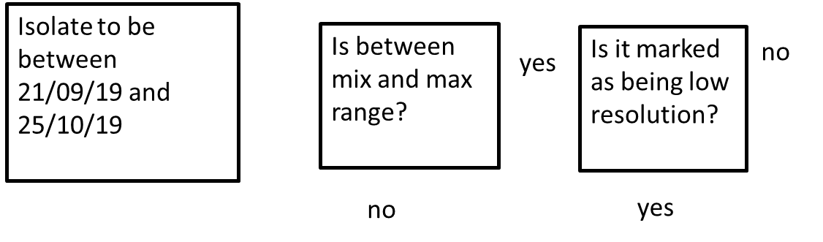
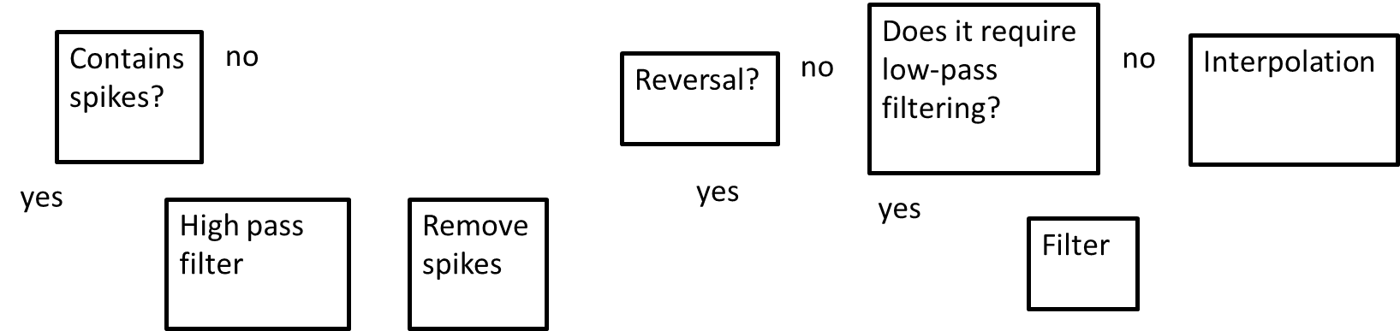
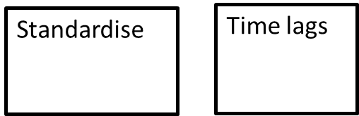
Pre-processing the inputs affected by the reversals process
Data pipeline 2
Zoom in
Because most of the tags identified for combination have also been identified for reversals, then we place the combination unit process before interpolation

Slide 7
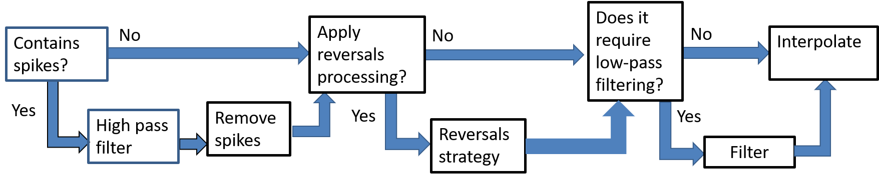
Pre-processing the inputs affected by the reversals process
Combine tags?
No
Interpolate
Yes
Combine

Slide 8
To-do (short-term)
Run the pre-processing tasks defined in the flow chart with the 170 inputs specified in the spreadsheet “UK5 AI Furnace Model Input Pre-Processing”.
Define a strategy to combine the signals identified with the “Indirect TagID” labels in the “UK5 AI Furnace Model Input Pre-Processing” spreadsheet.
Once the combination strategy is defined, identify groups of correlated tags using Feature Selection.
Updates related to the Multiple Linear Regression model.
To-do (longer-term)
Repeat analysis that use randomly selected inputs and/or randomly selected time lags.
Consider using a multi-output linear regression.

Slide 9
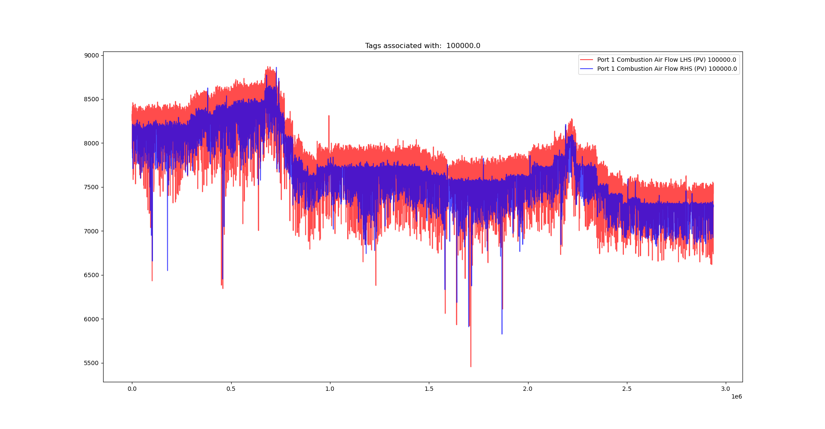
Tags identified for combination:
Standard combination
Zoom in

Slide 10
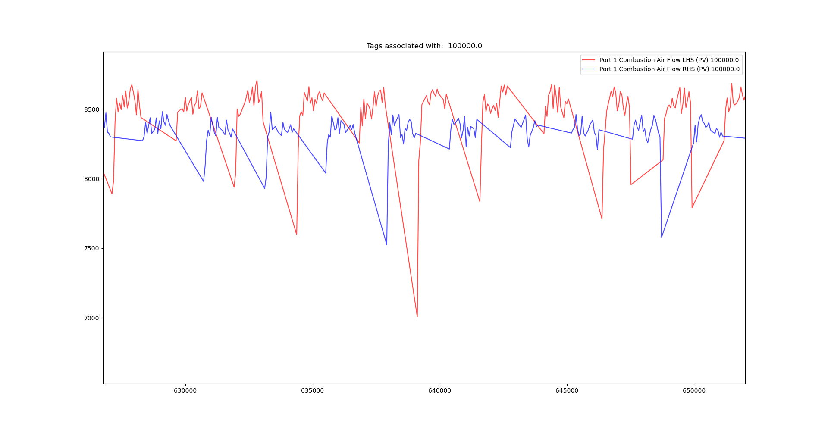
Tags identified for combination:
Standard combination

Slide 11
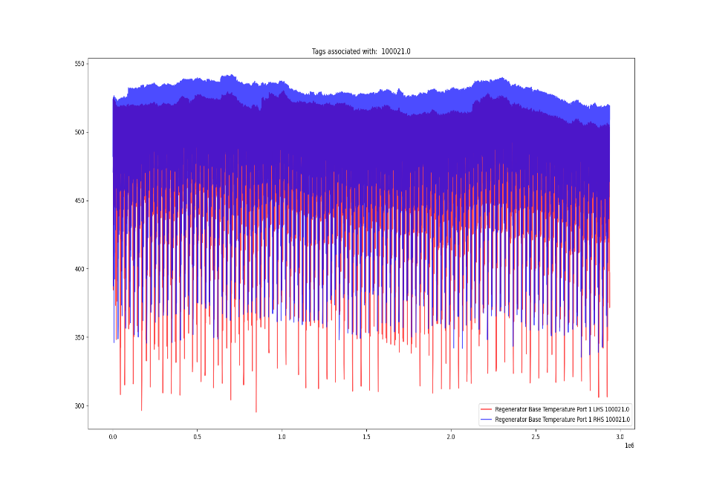
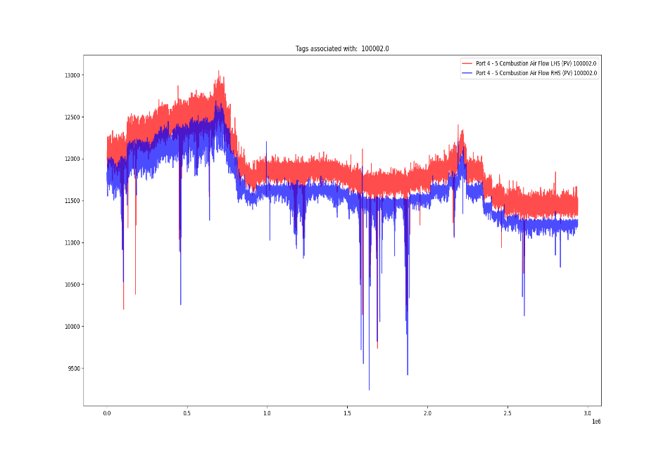
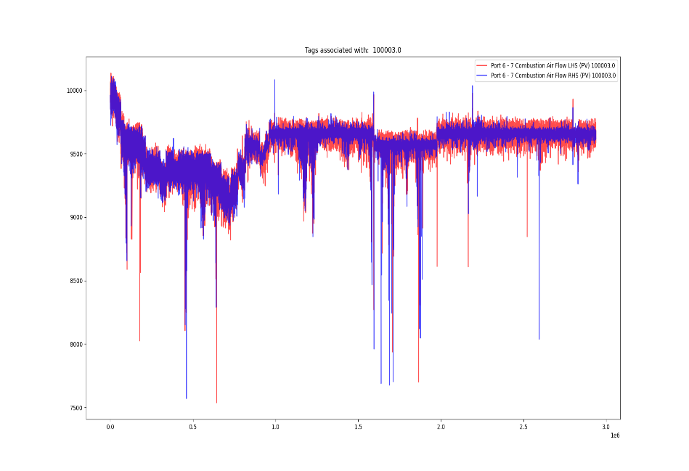
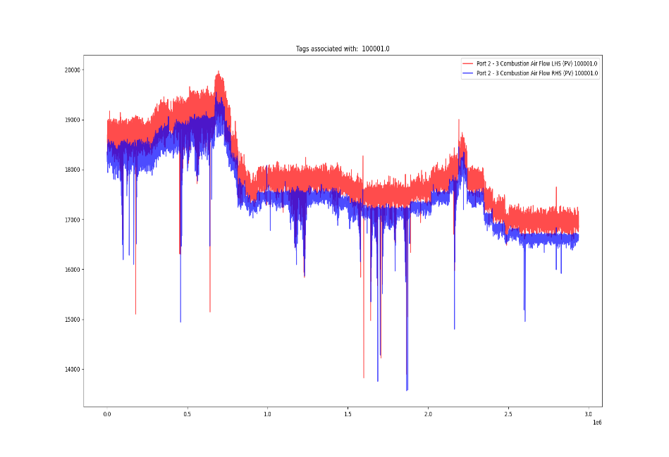
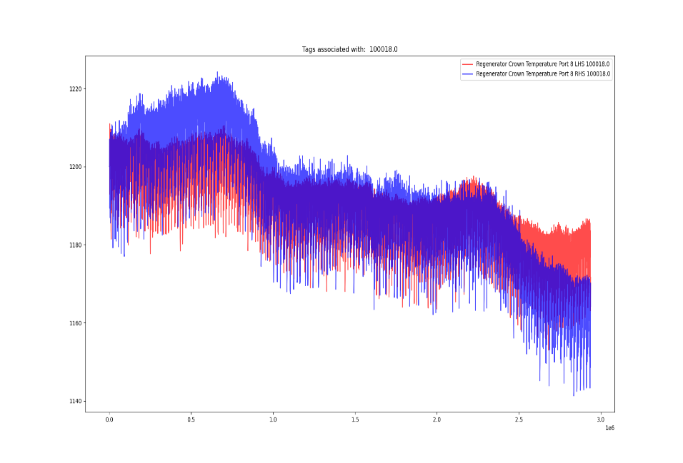

Tags identified for combination:
Tags identified for combination: Standard combination

Slide 12
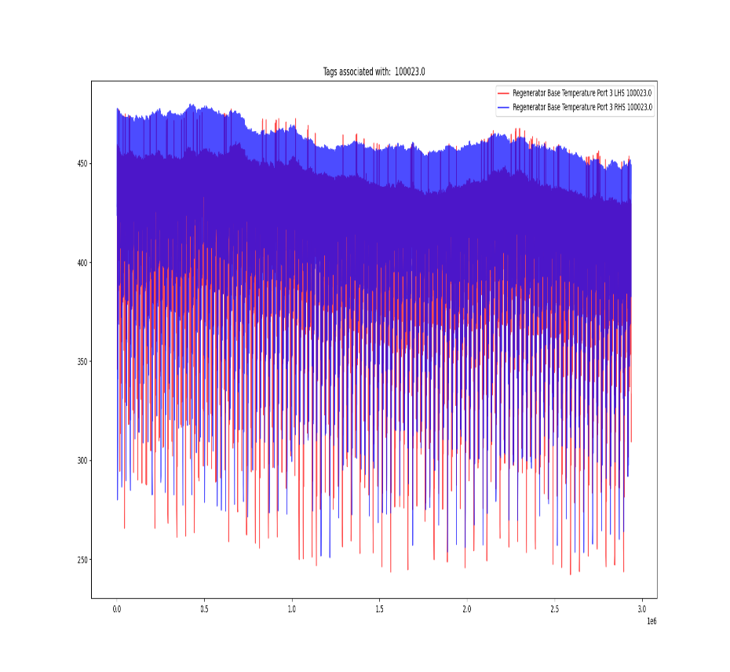
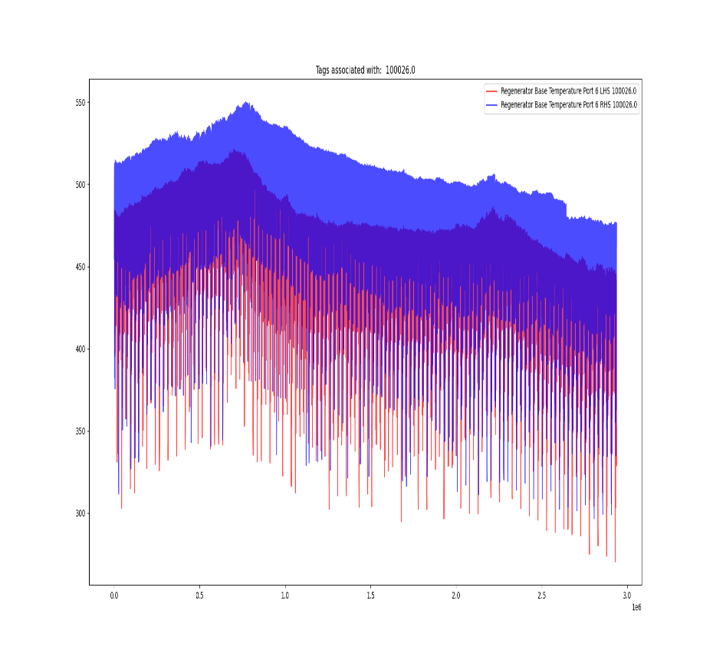
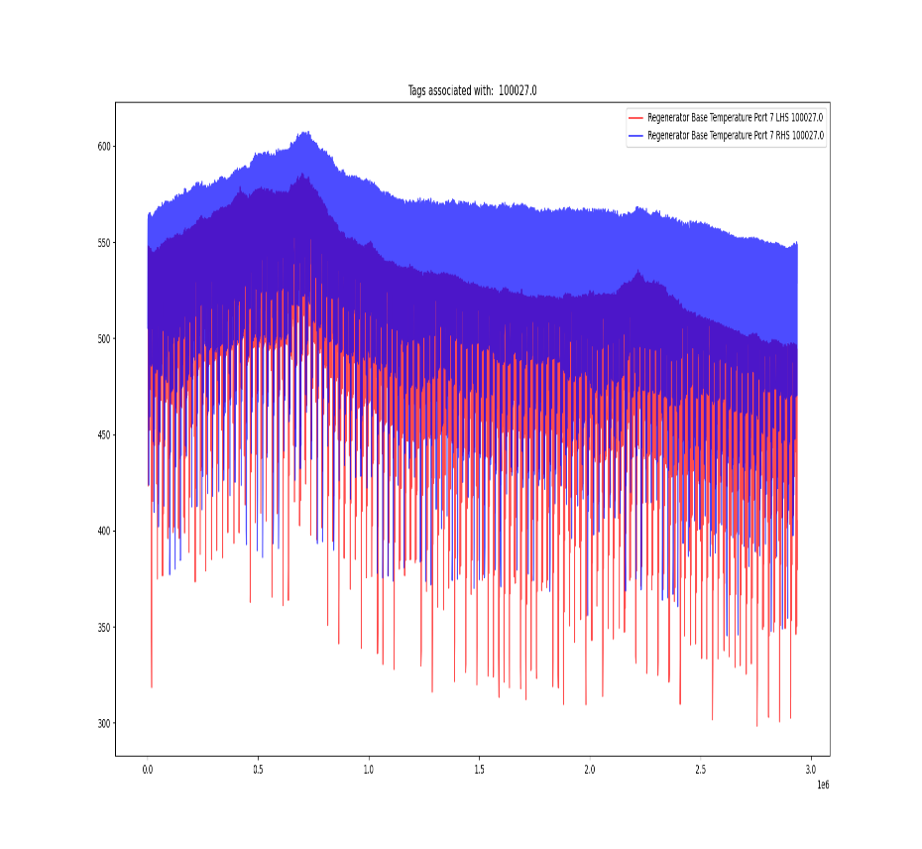
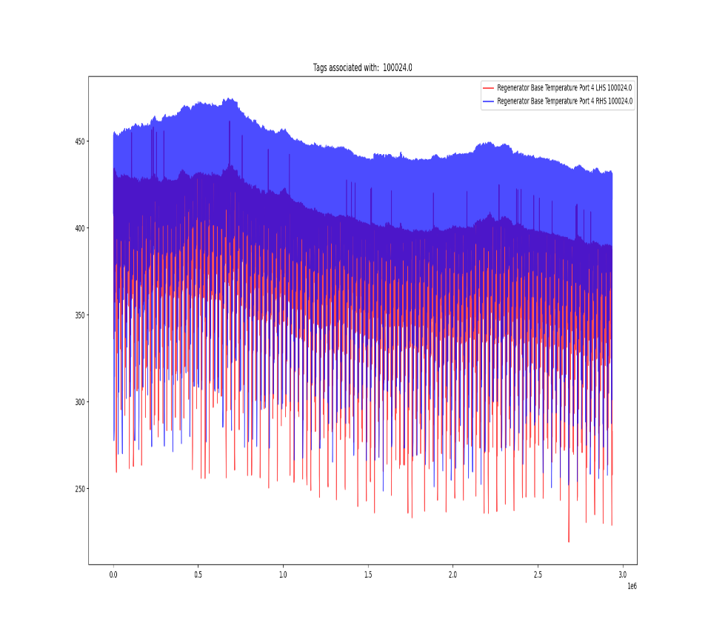
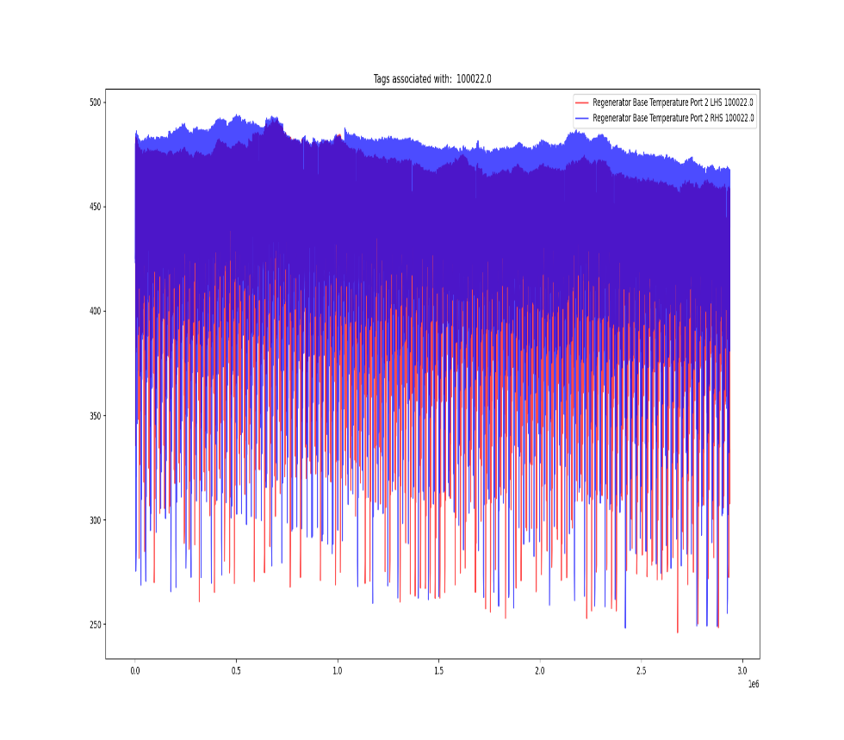
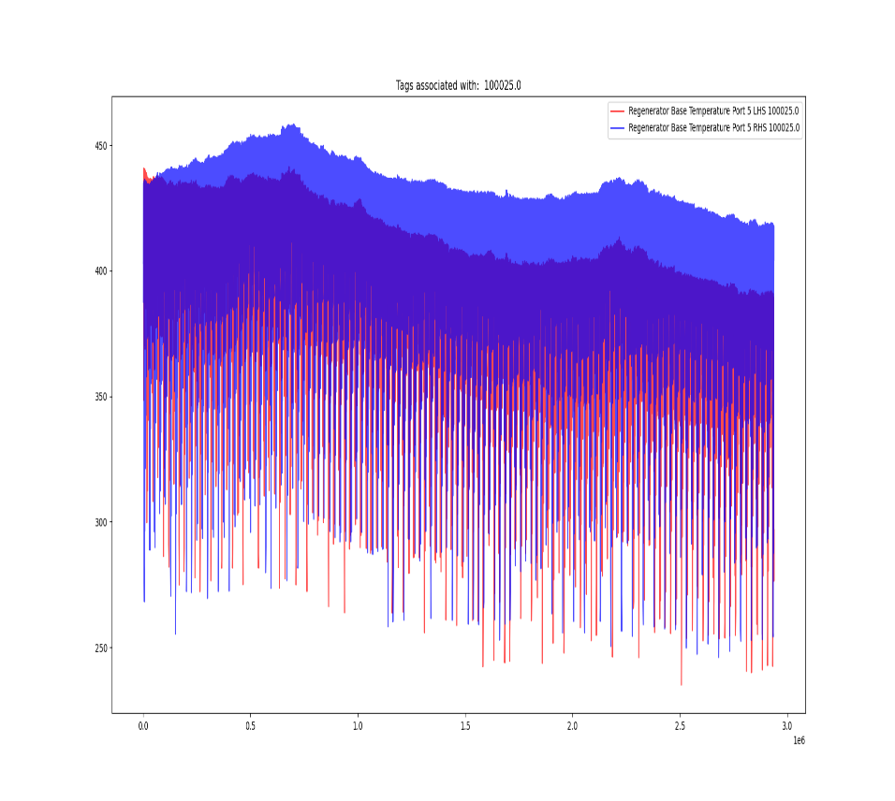
Tags identified for combination: Standard combination

Slide 13
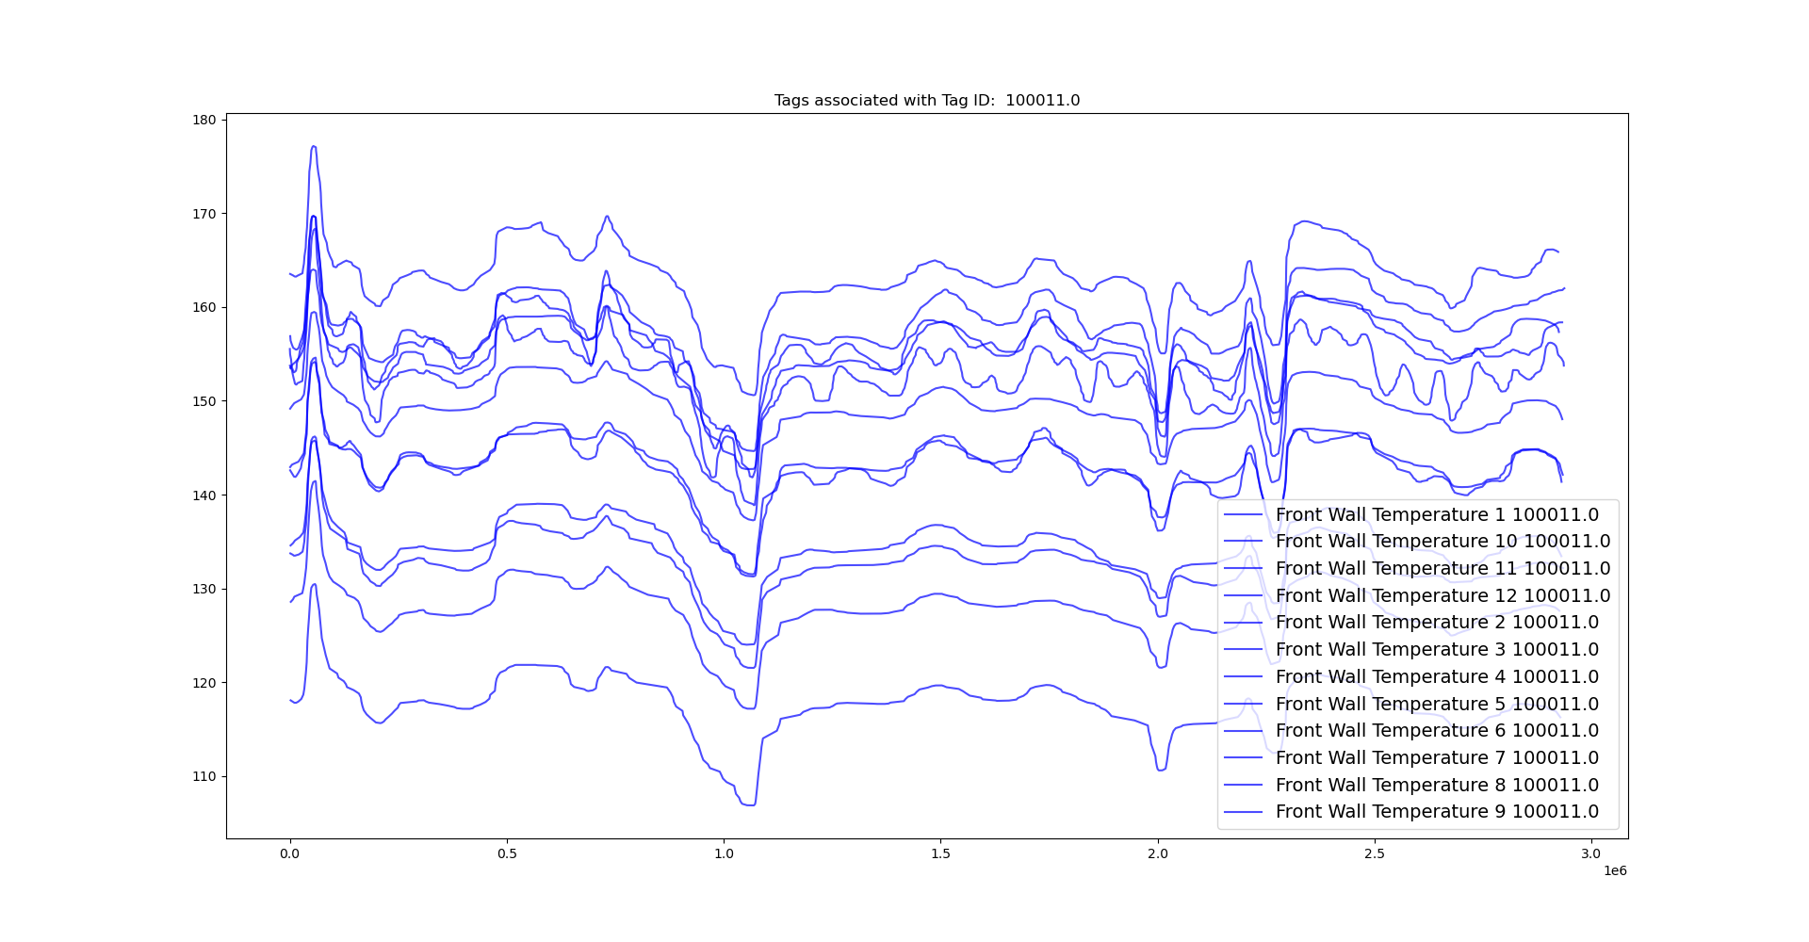
Tags identified for combination:
Special case 1

Slide 14
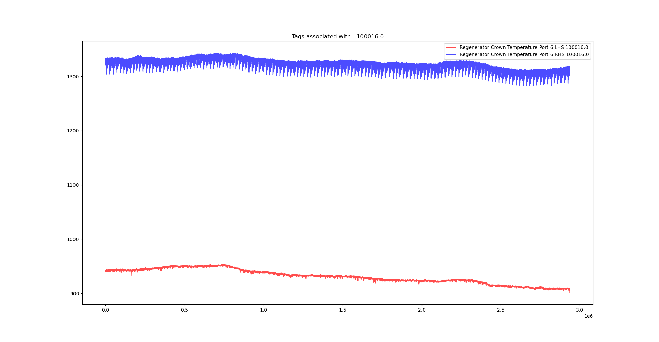
Tags identified for combination:
Special case 2

Slide 15

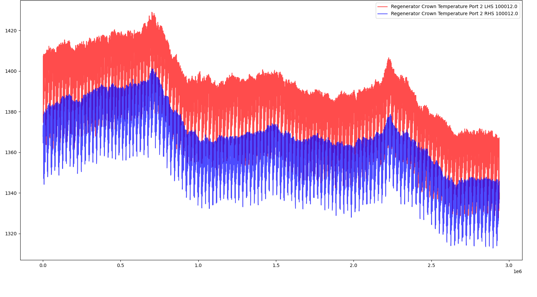
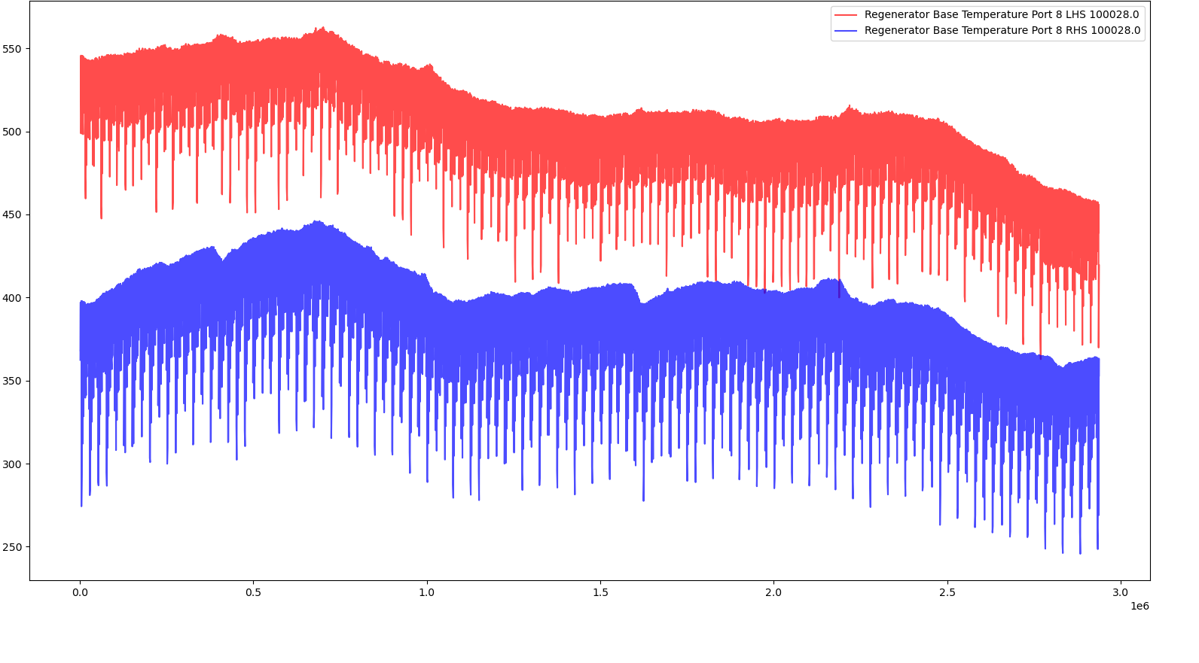
Tags associated with the Tag ID: 100016
Tags identified for combination:
Special case 2
Tags associated with the Tag ID: 100012
Tags associated with the Tag ID: 100028

Slide 16
Any recommendations for the special cases, 1 and 2?

Slide 17
To-do (short-term)
Run the pre-processing tasks defined in the flow chart with the 170 inputs specified in the spreadsheet “UK5 AI Furnace Model Input Pre-Processing”.
Define a strategy to combine the signals identified with the “Indirect TagID” labels in the “UK5 AI Furnace Model Input Pre-Processing” spreadsheet.
Once the combination strategy is defined, identify groups of correlated tags using Feature Selection.
Updates related to the Multiple Linear Regression model.
To-do (longer-term)
Repeat analysis that use randomly selected inputs and/or randomly selected time lags.
Consider using a multi-output linear regression.

Slide 18



Multiple linear regression model structure
$${\hat{y}}_{t+1}=f_{1}(y_{t}, x)$$
$${\hat{y}}_{t+2}=f_{2}({\hat{y}}_{t+1}, x)$$
$${\hat{y}}_{t+3}=f_{3}({\hat{y}}_{t+2}, x)$$

Slide 19



Multiple linear regression model structure
$${\hat{y}}_{t+1}=f_{1}(y_{t}, x)$$
$${\hat{y}}_{t+2}=f_{2}({\hat{y}}_{t+1}, x)$$
$${\hat{y}}_{t+3}=f_{3}({\hat{y}}_{t+2}, x)$$
Appropriately processed tag data (details in next slides…)

Slide 20
Processing lagged tag data to be used as inputs
Max lag
Fault
Density
future pred
Time
Tag 1
Time
Tag 2
Time
Now

Slide 21
Processing lagged tag data to be used as inputs
Adjust for time lags…
Max lag
Fault
Density
future pred
Time
Tag 1
Lag 1 + future pred
Time
Tag 2
Time
Now

Slide 22
Processing lagged tag data to be used as inputs
Adjust for time lags…
Max lag
Fault
Density
future pred
Time
Tag 1
Lag 1 + future pred
Time
Tag 2
Lag 2 + future pred
Time
Now

Slide 23
Processing lagged tag data to be used as inputs
Remove data where we can’t realise predictions
Max lag
Fault
Density
future pred
Time
Tag 1
Time
Tag 2
Time
Now

Slide 24
Processing lagged tag data to be used as inputs
Left with input-output pairs for training etc.
Max lag
Fault
Density
future pred
Time
Tag 1
Time
Tag 2
Time
Now

Slide 25
Processing lagged tag data to be used as inputs
This box demonstrates the processing we are conducting, but there’s one step missing…
tag data time lag
future pred
max time lag
X=roll(tag data, time lag + future pred)
Del(X[max time lag + future pred :])
X

Slide 26
Processing lagged tag data to be used as inputs
Fault
Density
future pred
Time
Tag 1
Time
Now

Slide 27
Processing lagged tag data to be used as inputs
Fault
Density
future pred
Time
Tag 1
Time
Now
Cannot use input if future pred > time lag for Tag 1

Slide 28
Processing lagged tag data to be used as inputs
tag data time lag
future pred
max time lag
Is abs(time lag) >
abs(future pred) ?
X=roll(tag data, time lag + future pred)
Del(X[max time lag + future pred :])
Yes
X
No

Slide 29
Processing furnace fault data
Can also use to process furnace fault data for training outputs using the same algorithm:
tag data time lag
future pred
max time lag
Is abs(time lag) >
abs(future pred) ?
X=roll(tag data, time lag + future pred)
Del(X[max time lag + future pred :])
Yes
X
No

Slide 30
Processing furnace fault data
Can also use to process furnace fault data for training outputs using the same algorithm:
furnace faults
-future pred
future pred
max time lag
Is abs(time lag) >
abs(future pred) ?
X=roll(furnace faults, 0)
Del(X[max time lag + future pred :])
Yes
X
No

Slide 31
Processing previous model predictions as inputs
Fault
Density
future pred
Time
Predicted fault
density
Time

Slide 32
Processing previous model predictions as inputs
Fault
Density
Time
Predicted fault
density
Time

Slide 33
Processing previous model predictions as inputs
Fault
Density
Time
Predicted fault
density
Time

Slide 34
Processing previous model predictions as inputs
Fault
Density
Time
Predicted fault
density
Time

Slide 35
Processing previous model predictions as inputs
Fault
Density
Time
Predicted fault
density
Time

Slide 36
Processing previous model predictions as inputs
Fault
Density
Time
Predicted fault
density
Time
Can simply shift previous predictions by one point to the make the previous model’s predictions part of the input for the new model.

Slide 37
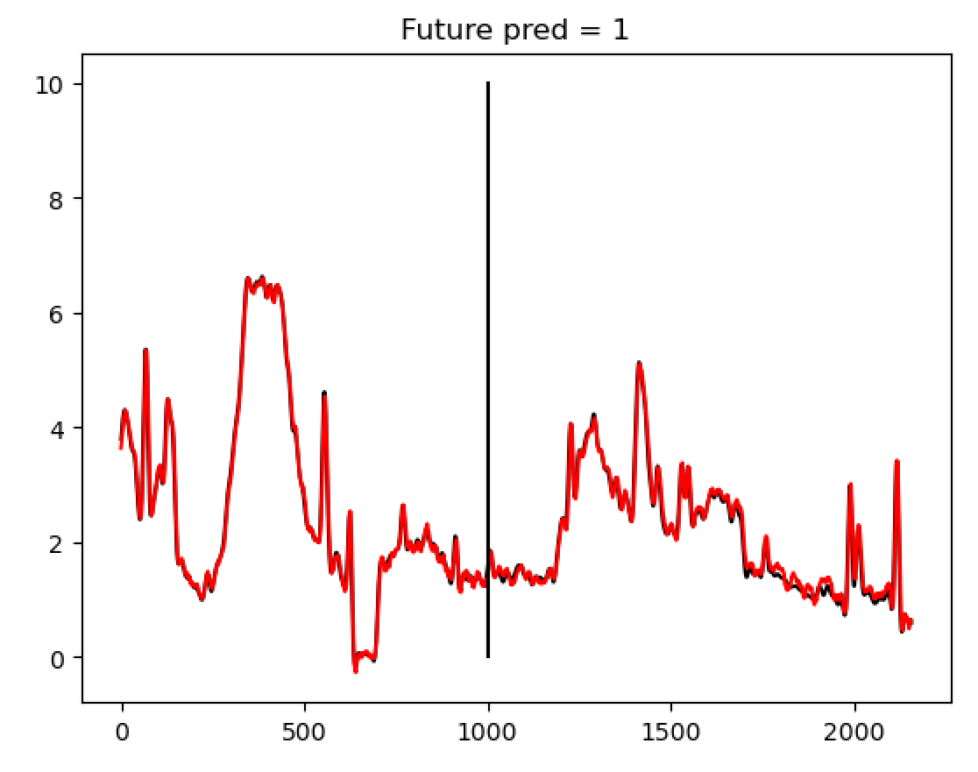
Training data (batch learning for now; online version future work)
Measured
Predicted

Slide 38
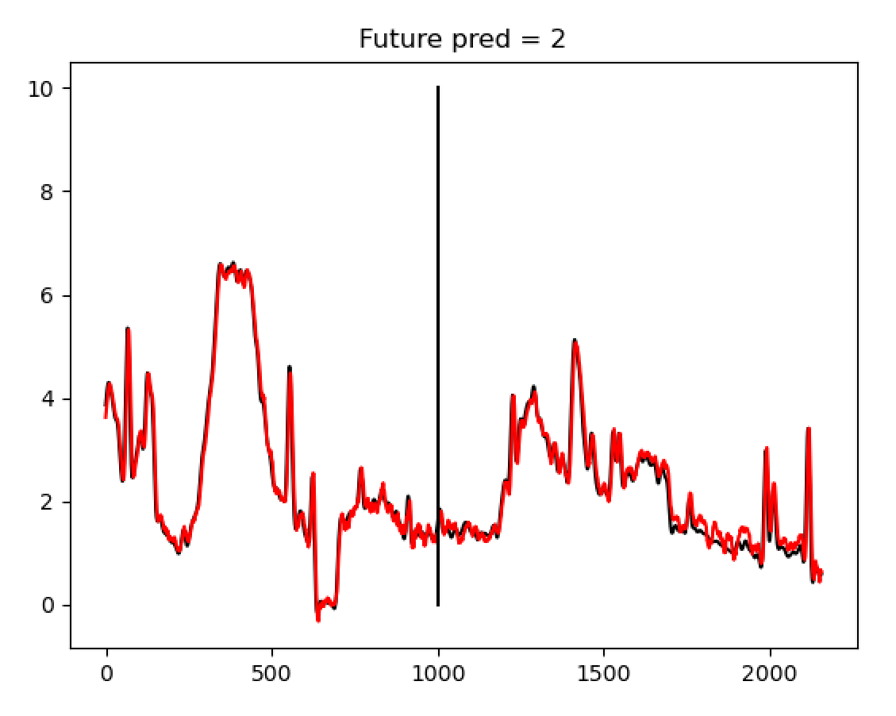
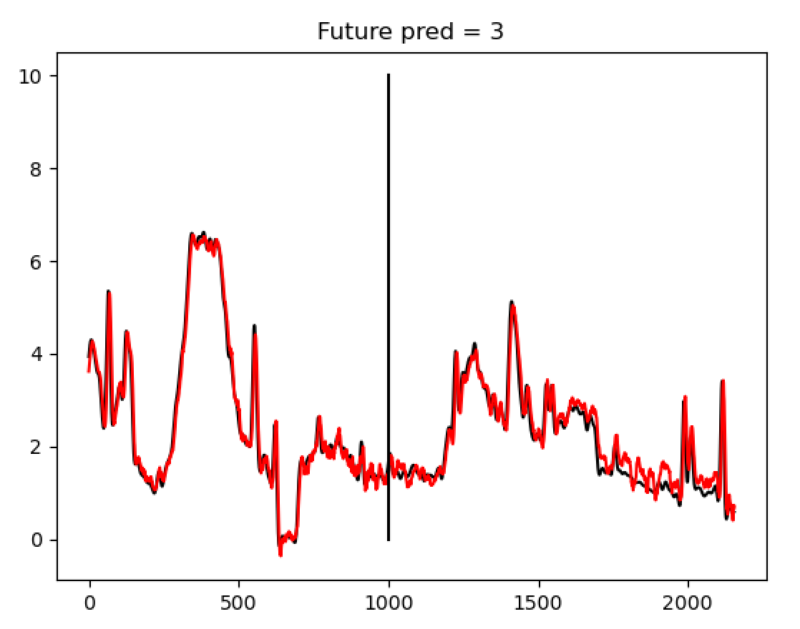
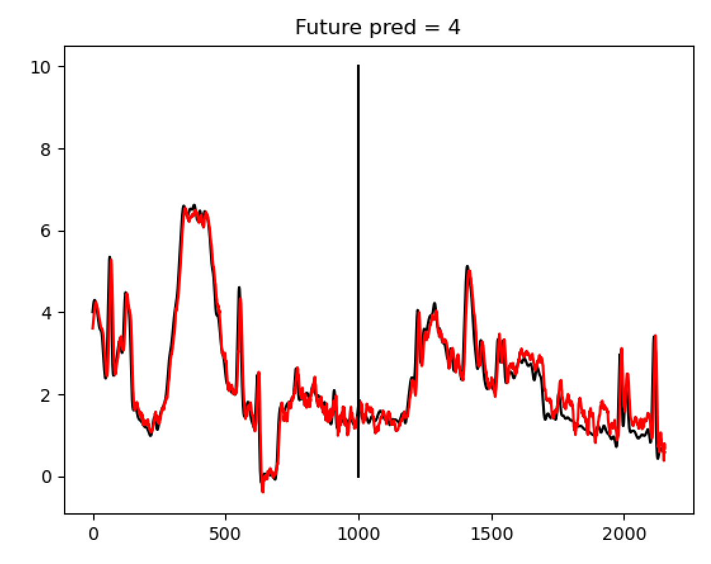
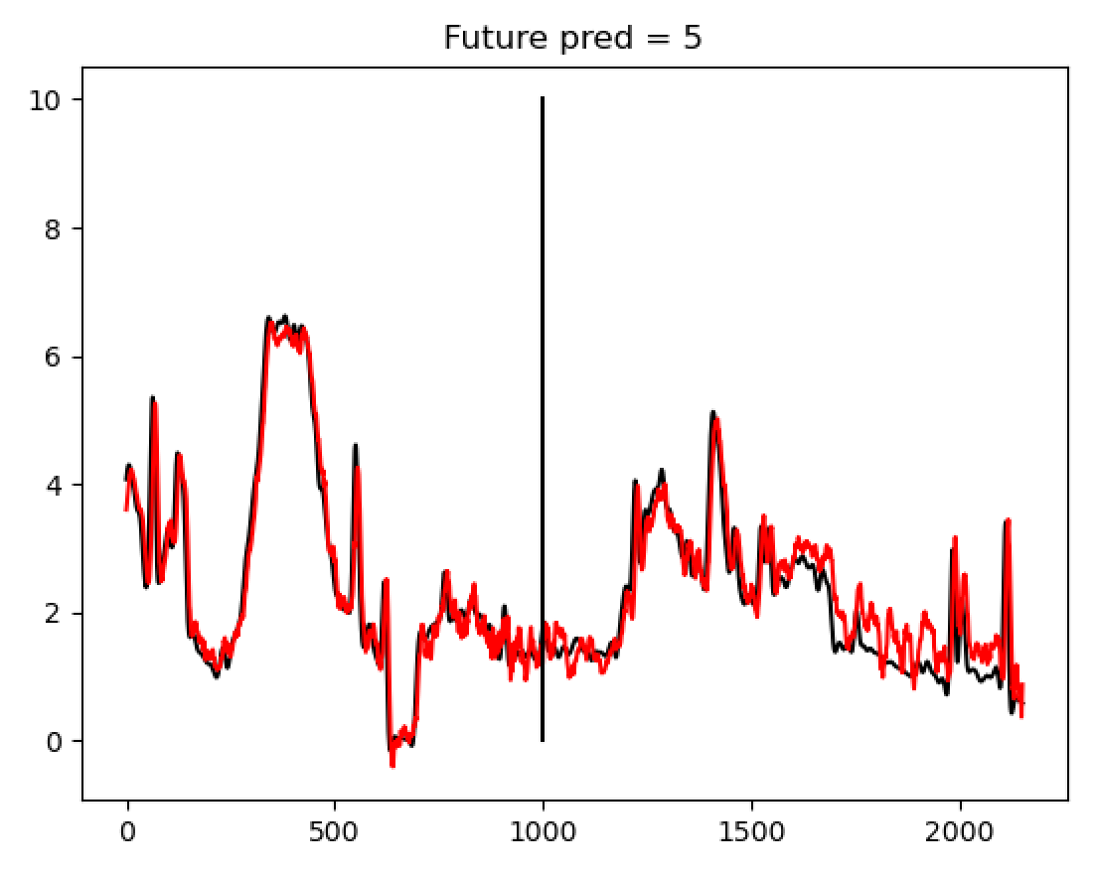
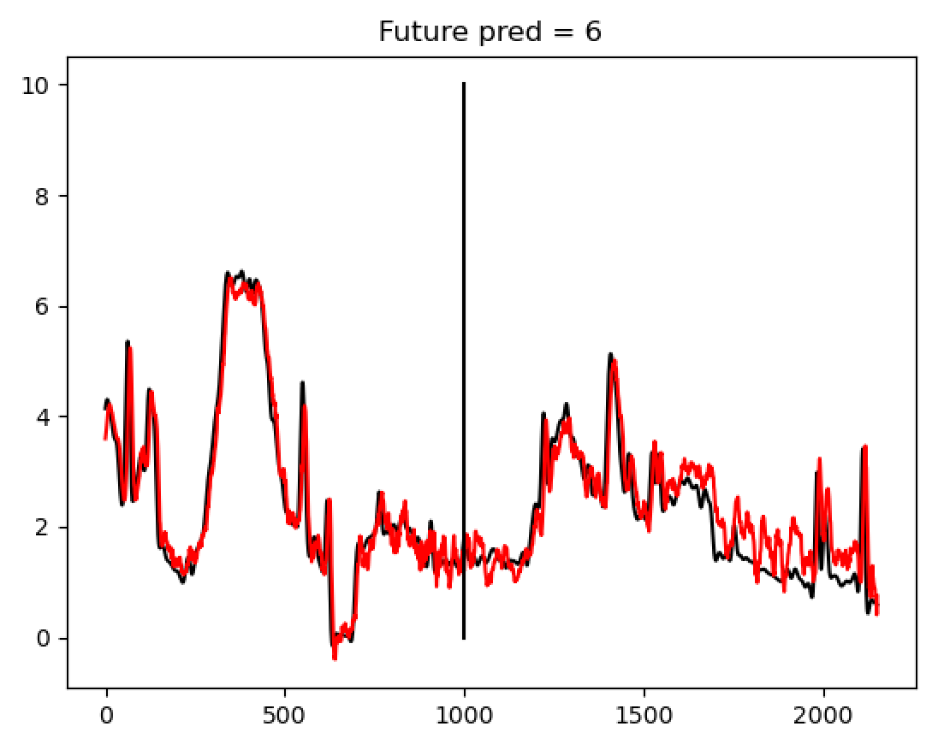
Measured
Predicted

Slide 39
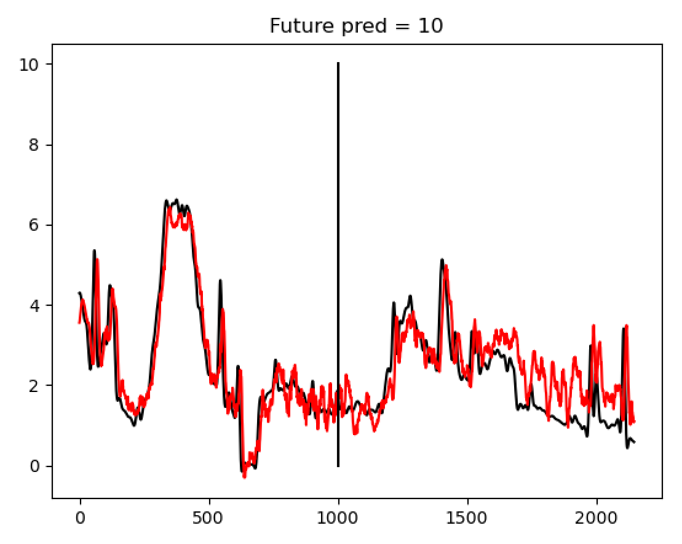
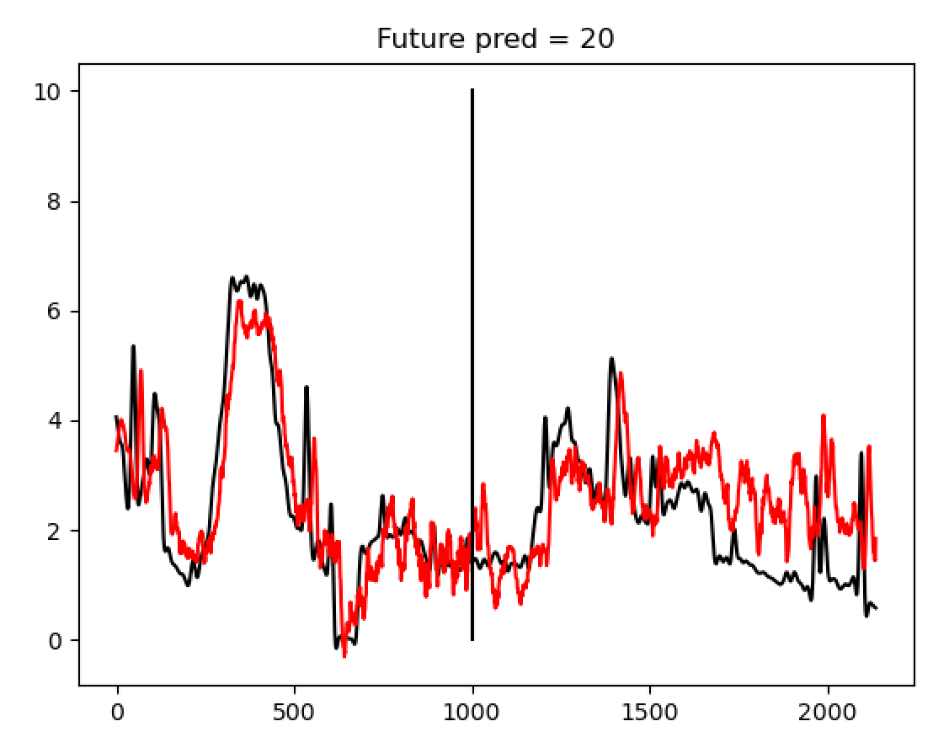
Measured
Predicted

Slide 40
Multiple linear regression model structure
Very early results at this point; need to develop tests for this code etc.
Haven’t included regularisation yet (to help prevent overfitting)
Haven’t removed inputs with low thetas yet (also to prevent overfitting)
Currently using the now out-of-date 74 inputs; will merge with Diego’s work later
Currently batch-trained, not online
Can be ‘plugged in’ to the end of our data processing pipeline

Slide 41
Next activities
To-do (short-term)
Test the post-processed signals.
Identify groups of correlated tags using Feature Selection.
Ensemble the final training dataset.
Updates related to the Multiple Linear Regression model.
To-do (longer-term)
Repeat analysis that use randomly selected inputs and/or randomly selected time lags.
Multi-output linear regression.

Slide 42
Thank you for your attention. ANY QUESTIONS?

